Slide 1
Lab 2 Progress
Dave Hand, Tim Nugent, Steve Coppi

Slide 2
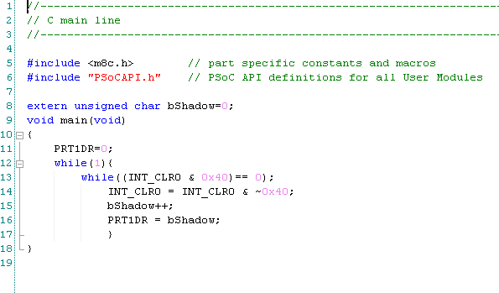
Lab 2a code
Code to create binary counter with 4 on-board LEDs.

Slide 3
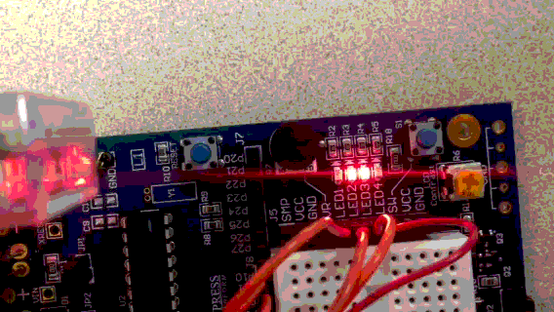
Lab 2a working
Gif only viewable in presentation mode.

Slide 4
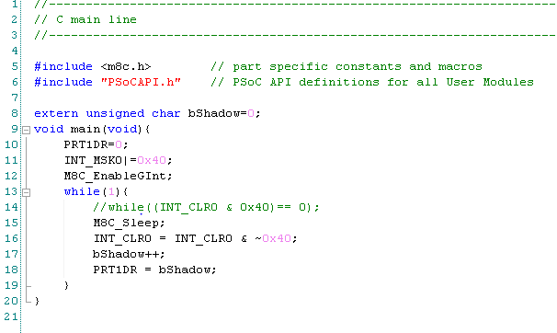
Lab 2b code
Adjusted code by enabling sleep timer interrupt and replaced code waiting for posted interrupt with sleep command.

Slide 5
Lab 2b working
Gif only viewable in presentation mode.

Slide 6
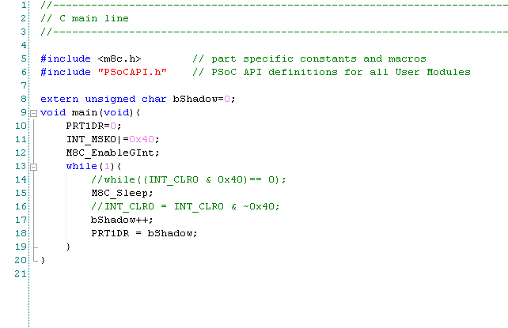
Lab 2c code
Adjusted code by enabling global interrupts and removed code for clearing sleep timer interrupt.

Slide 7
Lab 2c working
Gif only viewable in presentation mode.

Slide 8
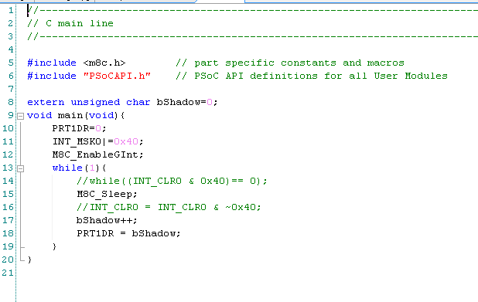
Lab 2d code
Adjusted program by adding assembly file for pushing accumulator value onto stack. The ljmp command was utilized.

Slide 9
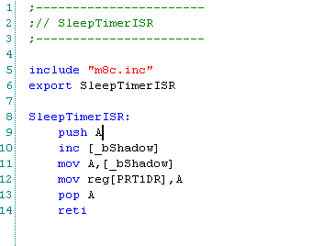
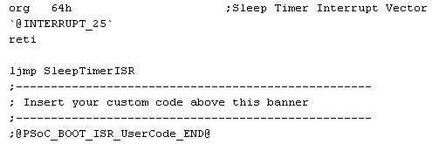
Lab 2d code (con’t)

Slide 10
Lab 2d working
Gif only viewable in presentation mode.

Slide 11
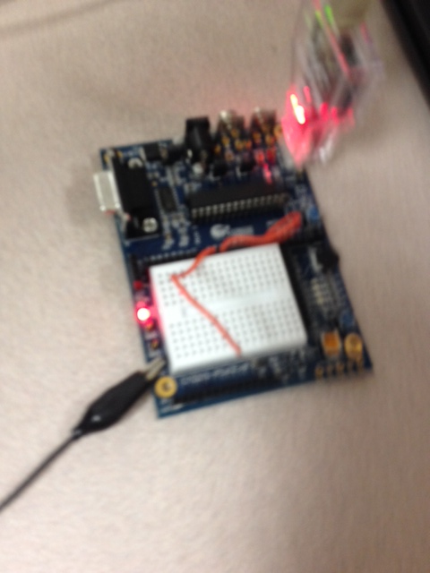
Lab 2 PSoC Picture

